Slide 1

Week #8
AI Academy®
1
Day 1:
Introduction of Digital Marketing
Importance of Digital Marketing
Traditional & Digital Marketing Diff.
Target Audience
Reviews & Feedbacks

Slide 2
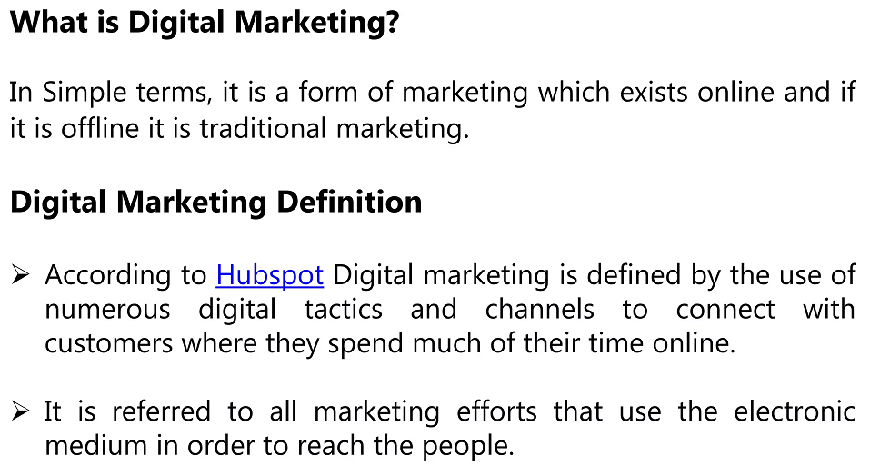
Week #8
AI Academy®
2

Slide 3
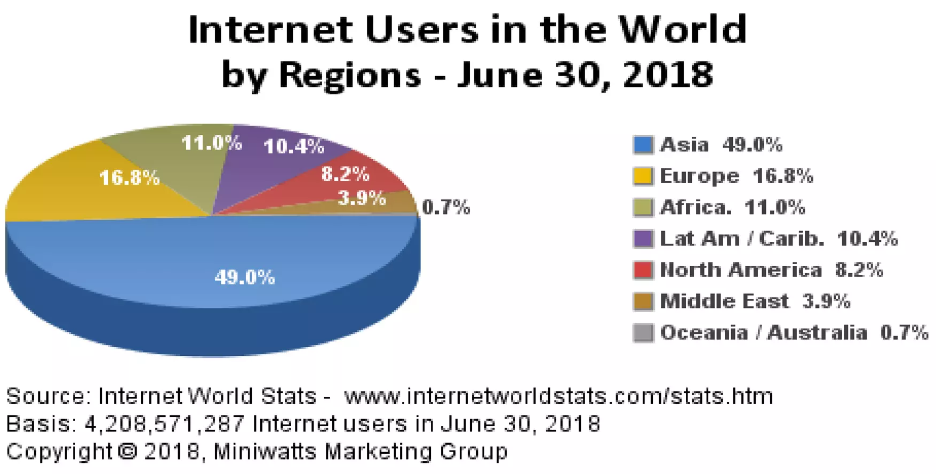
Week #8
AI Academy®
3

Slide 4
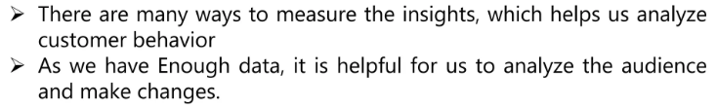
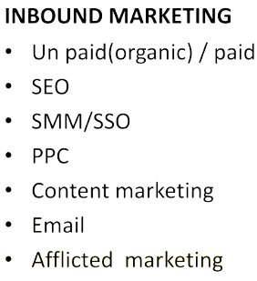
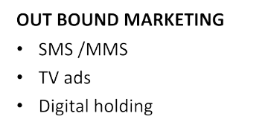
Week #8
AI Academy®
4

Slide 5
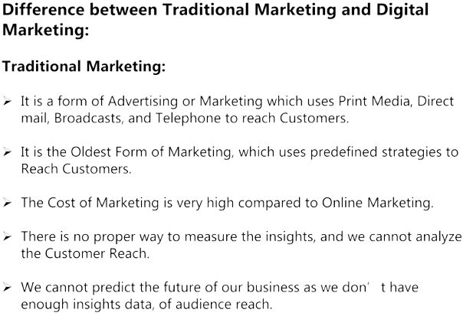
Week #8
AI Academy®
5

Slide 6
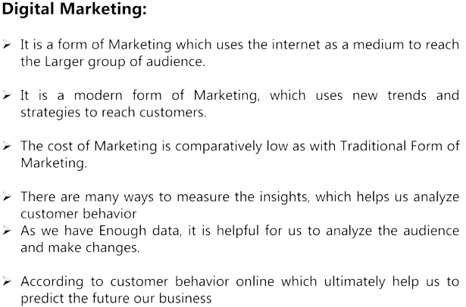
Week #8
AI Academy®
6

Slide 7
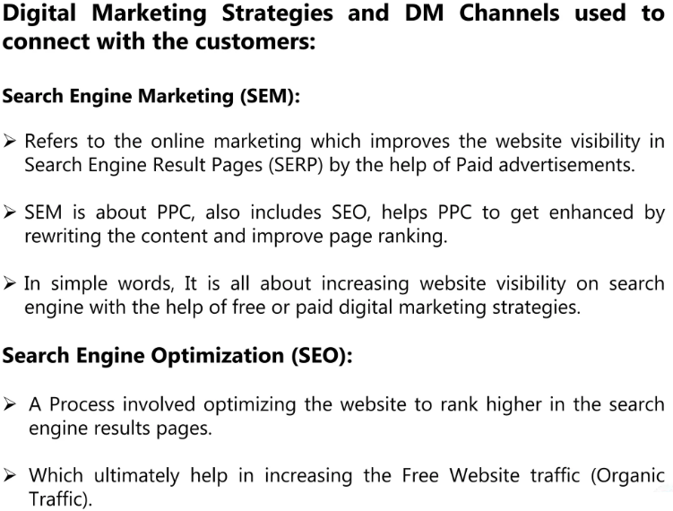
Week #8
AI Academy®
7

Slide 8
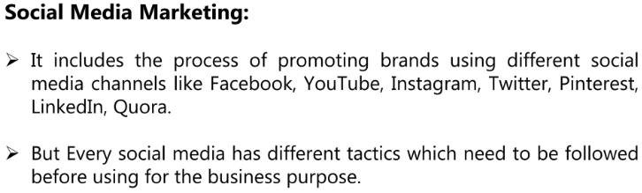
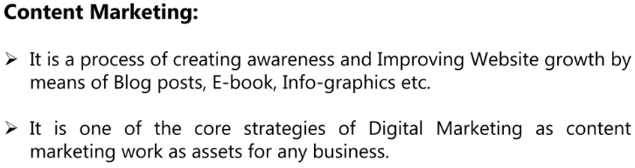
Week #8
AI Academy®
8

Slide 9
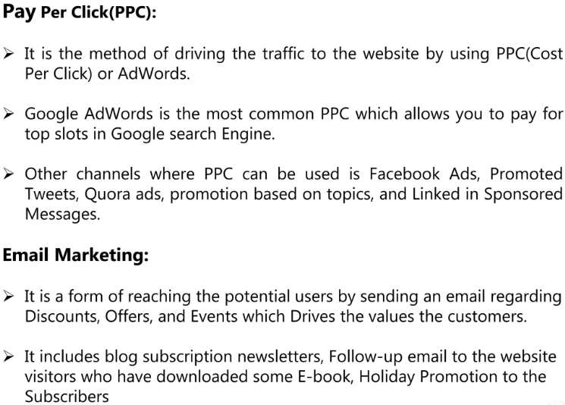
Week #8
AI Academy®
9

Slide 10
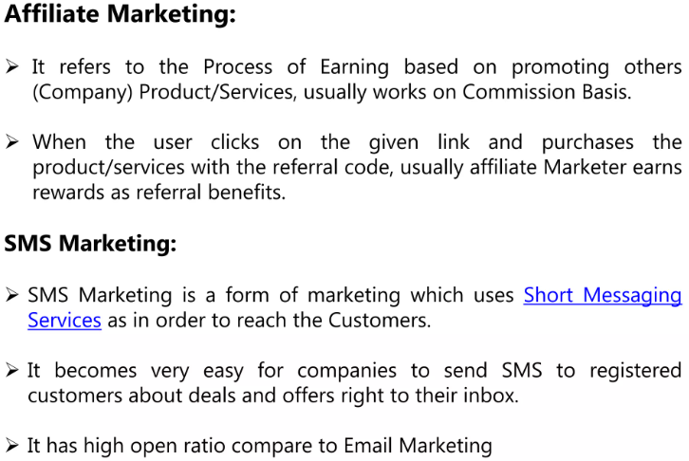
Week #8
AI Academy®
10

Slide 11
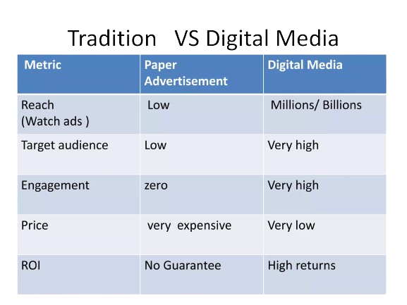
Week #8
AI Academy®
11

Slide 12
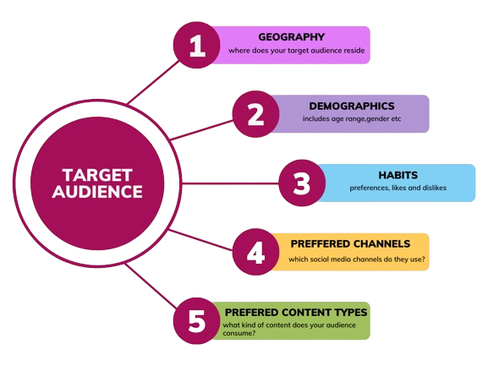
Week #8
AI Academy®
12

Slide 13
Week #8
AI Academy®
13
Day 2:
Introduction of Social Media?
Different Social Media Platforms
Marketing Plans & Strategies for eCommerce
Reviews & Feedbacks

Slide 14
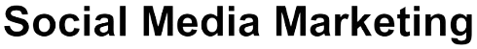
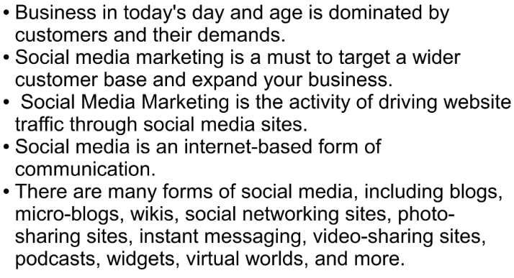
Week #8
AI Academy®
14

Slide 15
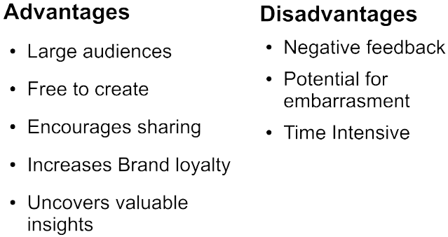
Week #8
AI Academy®
15

Slide 16
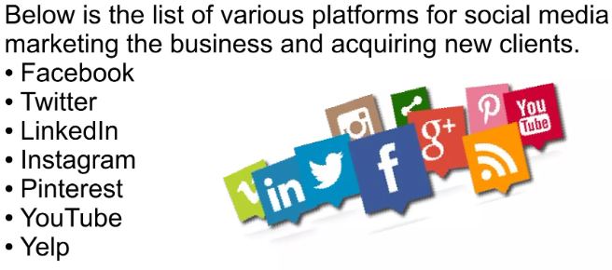
Week #8
AI Academy®
16

Slide 17
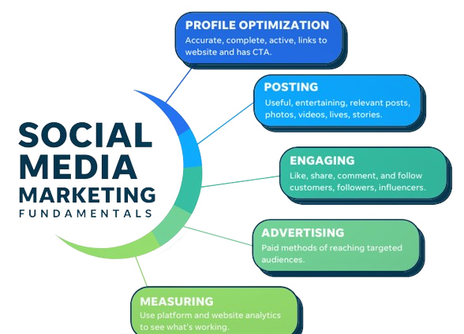
Week #8
AI Academy®
17

Slide 18
Week #8
AI Academy®
18
Day 3:
What is SEO & Importance?
Keyword Search
On page SEO
Off page SEO
Reviews & Feedbacks

Slide 19
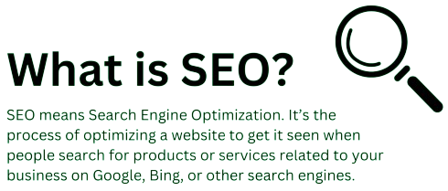
Week #8
AI Academy®
19

Slide 20
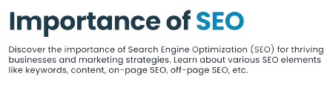
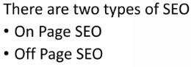
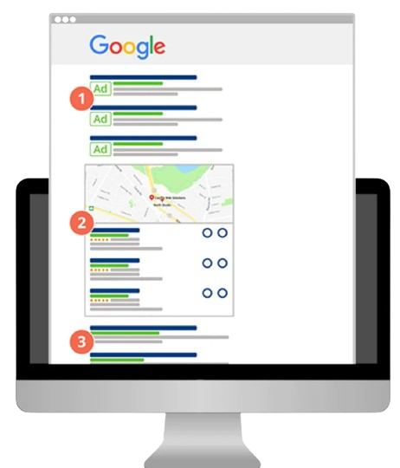
Week #8
AI Academy®
20

Slide 21
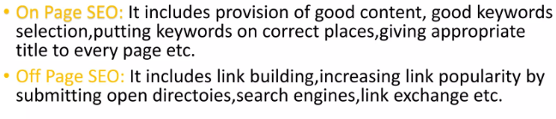
Week #8
AI Academy®
21

Slide 22

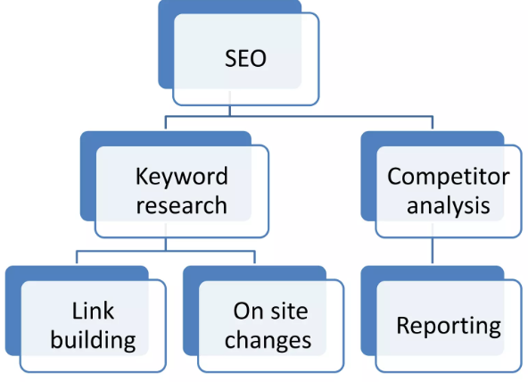
Week #8
AI Academy®
22

Slide 23
Week #8
AI Academy®
23
Day 4:
What is Email Marketing?
Crafting Effective Strategies
Campaigns
Reviews & Feedbacks

Slide 24
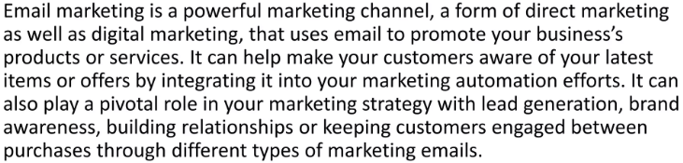
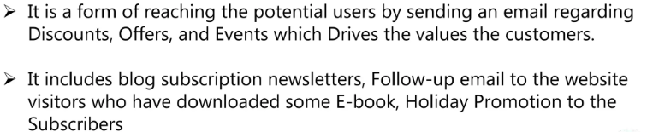
Week #8
AI Academy®
24

Slide 25
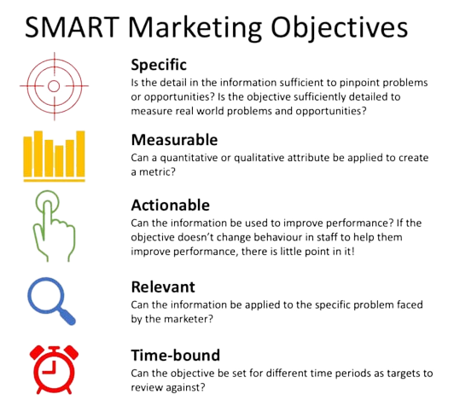
Week #8
AI Academy®
25

Slide 26
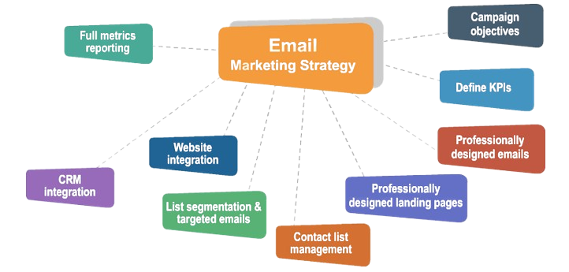
Week #8
AI Academy®
26

Slide 27
Week #8
AI Academy®
27
Day 5:
What is Advertisement?
Introduction & Importance of
Local Social Platforms
Global Social Platforms
Reviews & Feedbacks

Slide 28
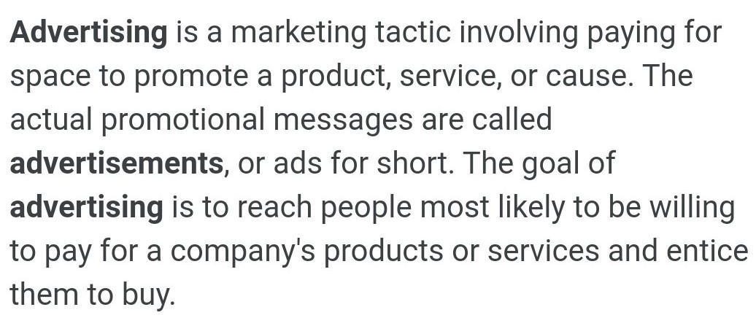
Week #8
AI Academy®
28

Slide 29
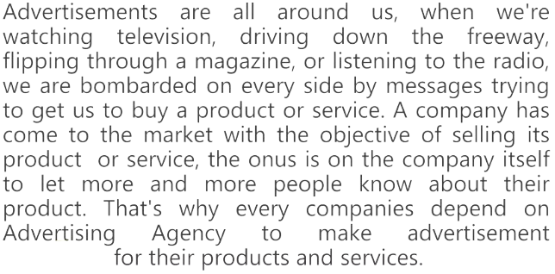
Week #8
AI Academy®
29

Slide 30
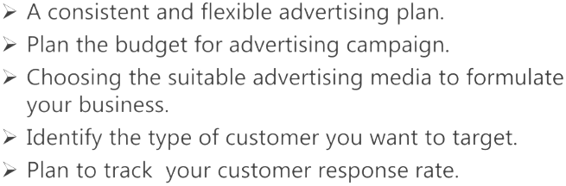
Week #8
AI Academy®
29

Slide 31
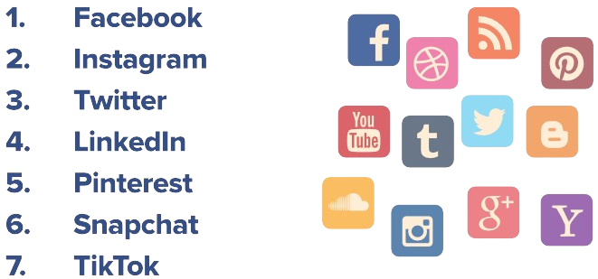
Week #8
AI Academy®
30

